Slide 1
云计算技术
陈果 副教授
湖南大学-信息科学与工程学院-计算机与科学系
邮箱：guochen@hnu.edu.cn
个人主页：1989chenguo.github.io
https://1989chenguo.github.io/Courses/CloudComputing2018Spring.html

Slide 2
What we have learned
What is cloud computing
Cloud Networking
Physical Structure
Applications and network traffic
Host networking virtualization
Addressing & Routing
Software-Defined Networking Architecture
Inter-data-center networking
Content distribution networks
Client connectivity
Internet latency is not good and difficult to solve
CDN alone is not enough; Need client-side collaboration
Case study for accelerating webpage load time
QUIC, VROOM

Slide 3
Coping with network performance
Part I: Cloud networking
Most materials from UIUC MOOC
Ankit Singla
ETH Zürich
P. Brighten Godfrey
UIUC
Credits to

Slide 4
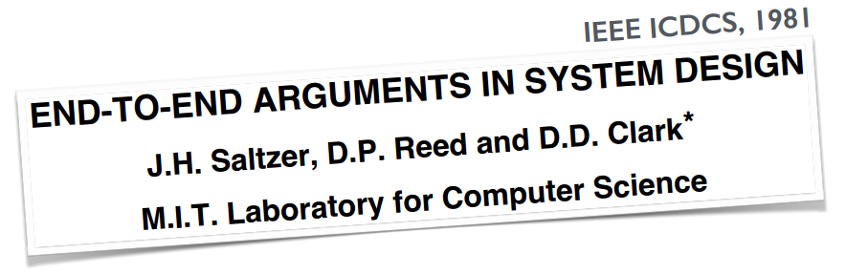
The end to end principle
“the end-to-end check of the file transfer application must still be implemented
no matter how reliable the communication system becomes”
Notes:
In a seminal paper dating back to 1981, Saltzer, Reed, and Clark made the end-to-end argument. Their point is best illustrated with an example. Consider an application whose function is reliable file transfer between two application end-points separated over a network. There are many sources of error possible: for instance, the network’s links or routing devices could drop some of the data or corrupt it, or the end host network stacks could have errors. One can try and eliminate all the possible known sources of error by careful engineering— this would not only be difficult and expensive to achieve, but could still leave out previously unknown sources of error. Thus, the application should itself check whether the data is correctly transferred or not — perhaps by a checksum; if the check fails, the application could retry the transfer. Of course, this is not to say that the network should be built to be lousy — the more reliable the network, the less likely that the end-to-end check will fail and the application will need to retry the file transfer. But ultimately, the responsibility for ensuring correctness of the data lies with the application. To quote Saltzer, Reed, and Clark: …
They also describe an instructive incident to drive this point home: An MIT networked system used hop-by-hop checksums over every network hop. But within one network gateway, there was a small rate of errors in copying the data from the input to the output buffers. In this case, the ultimate end-to-end check was required: manual comparison and correction of some of the data that had been transferred over that connection.
The lesson here is that ultimately, applications have to deal with network conditions to suit their objectives.
Now, certain functions are desired by a large number of applications, so we build them into lower layers. For example, reliable, in-order packet delivery is something several applications want. So, TCP was built as something that applications could depend on — in this case, applications are delegating some trust to TCP, and TCP performs the checks for in-order packet delivery.
But for more “niche” application objectives, beyond what standard protocols have been engineered to provide, applications need to step in.
What we’ll discuss in this lesson is a sampling of techniques applications have used to meet their objectives.

Slide 5
A few examples in this lesson …
1
Redundant requests to lower tail latency
2
Application layer handling of TCP incast
3
Rate adaptation for video streaming
Notes:
We’ll talk about how applications can deal with latency in the tail.
How TCP incast can be handled, although with some compromises, at the application layer
and how video streaming deals with variations in network capacity.

Slide 6
A few examples in this lesson …
1
Redundant requests to lower tail latency
2
Application layer handling of TCP incast
3
Rate adaptation for video streaming
Notes:
We’ll talk about how applications can deal with latency in the tail.
How TCP incast can be handled, although with some compromises, at the application layer
and how video streaming deals with variations in network capacity.

Slide 7
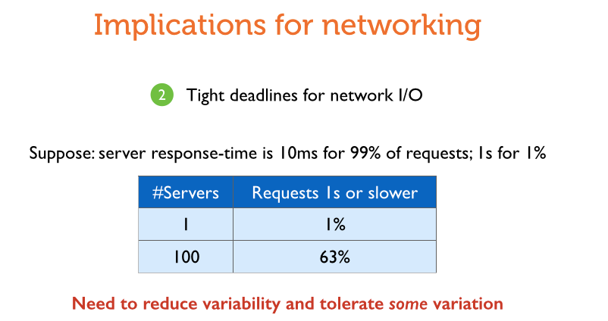
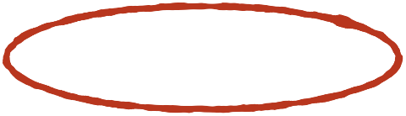
Latency in the tail
“the median workflow in production at Bing has 15 stages and 10% of the stages process the query in parallel on 1000s of servers”
— “Speeding up Distributed Request-Response Workflows”
Jalaparti et al., ACM SIGCOMM 2013
“loading one of our popular pages results in an average of 521 distinct items fetched from memcache”
— “Scaling Memcache at Facebook”
Nishtala et al., USENIX NSDI 2013
Notes:
Some data center applications exhibit traffic patterns which require lots of parallel requests, thus running into problems with such latency variation.
For instance, with Bing: … quote
and for Facebook … quote
If you’re making such large numbers of requests and the result depends on waiting for the last response, performance can be poor — many different factors are involved that contribute to the variation in latency that causes such problems: the shared environment in the cloud, different load on servers, errors, network congestion and loss. Given that it’s hard to control all of these, perhaps applications should deal with this variation with their own mechanisms.
One way of dealing with this problem is to settle for incompleteness in responses in favor of timeliness — i.e., have the application send-off the response to the user even if not all pieces of the response are included. This might mean a compromise in response quality. Bing, for example, might exclude search results from a search worker server. Of course, this is a rather last-resort method of mitigating the problem.

Slide 8
Latency in distributed data stores
“Rapid read protection allows the coordinator to monitor the outstanding requests and send redundant requests to other replicas when the original is slower than expected”
— DataStax, “Rapid read protection in Cassandra 2.0.2”
Notes:
A method of dealing with such latency variations is implemented in the Cassandra data store. For read operations, Cassandra implements what it calls rapid read protection. (Read quote)
Let’s look into what this means and how it works …

Slide 9


Latency in distributed data stores
“Rapid read protection allows the coordinator to monitor the outstanding requests and send redundant requests to other replicas when the original is slower than expected”
— DataStax, “Rapid read protection in Cassandra 2.0.2”
x
Replica1
Replica 2
Client
Replica 3
Coordinator
Notes:
In Cassandra, the client may request a read from a coordinator, which looks at the load at different replicas that can fulfill that read request, and picks the least loaded one.
Now, if this replica is slow to respond for some reason, the read latency suffers.
The rapid read protection mechanism simply has the coordinator monitor the outstanding requests and issue redundant requests if the outstanding request is taking too long.
A similar approach has also been used in Google’s BigTable

Slide 10
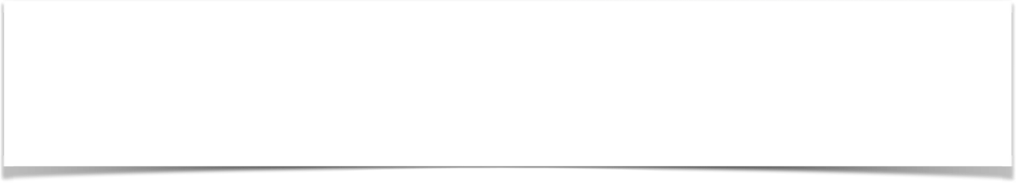
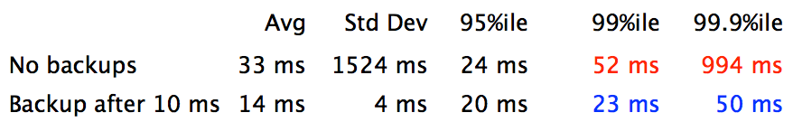
Latency in distributed data stores
“Rapid read protection allows the coordinator to monitor the outstanding requests and send redundant requests to other replicas when the original is slower than expected”
— DataStax, “Rapid read protection in Cassandra 2.0.2”
“Achieving Rapid Response Times in Large Online Services”, Jeff Dean @ Google, 2012
Notes:
The rough idea is the same as what I described for Cassandra. In addition, the BigTable mechanism has a request cancellation feature, which means, after the arrival of the first response, the other query can be cancelled, in order to mitigate the cost of doing additional work. You can find the details in Google’s Jeff Dean’s talk, which we’ve linked on the course page.
Jeff Dean showed results from requesting 1000 keys spread across 100 tables. The latency is measured as the time until the arrival of the last response.
Issuing backup requests to a replica substantially reduced tail latency. The “Backup after 10ms” scheme requests a key that didn’t arrive within 10ms from a replica. As soon as the key arrives, if a redundant request is outstanding, it will be cancelled. This gives a latency reduction from almost a second to 50ms in the 99.9th percentile. And because of the cancellation mechanism, only a 5% extra key request load.
So, in this case, a very simple application-layer mechanism achieves a vast improvement, with very little cost! Note that if the requests you’re making manipulate system state — for example, flipping a bit, then you’ll need additional effort to make backup requests work. But even in the simpler case, why does this technique work, and what are its costs in general?

Slide 11
When and why does this work?
Server response-time is 10ms for 99% of requests; 1s for 1%.
P(request is slow) = 0.01
P(request is slow AND redundant request is slow)
= P(request is slow) * P(request is slow)
= 0.0001
Crucial assumption: independence across requests
Notes:
Let’s look at an example, where the server response-time is 10ms for 99% of requests, and 1s for the remaining 1% of requests.
So the probability of the request being slow, i.e., taking 1s is 0.01
Now, say we’re making a redundant request with every request, what’s the likelihood that both requests are slow?
IF we assume that request latencies are not correlated, i.e. each request independently has probability 0.01 of being slow, then we simply get a product of these probabilities i.e. 1 in 10000 chance of the request being slow.
Now, replicating every request can be costly if you’re making a large number of requests. Let’s look at that case.

Slide 12

When and why does this work?
Server response-time is 10ms for 99% of requests; 1s for 1%.
My job is 100 requests. What is the likelihood it takes 1s?
“Bad” event | Probability
≥ 1 slow requests | 0.63
≥ 2 slow requests | 0.26
≥ 3 slow requests | 0.08
≥ 4 slow requests | 0.02
≥ 5 slow requests | 0.003
What if we replicated requests outstanding after 10ms?
Crucial assumption: independence across requests
Notes:
Let’s say our job consists of 100 requests issued all at once and we consider the job done when all responses arrive. What is the likelihood it takes 1s?
Now, the job will be slow if at least 1 request out of 100 takes 1s. What’s the likelihood of this? You can compute this probability easily to be 0.63. Obviously, this is horrible — almost 2/3rds of the time, you’re spending 1 second!
But let’s investigate this a bit more. What’s the probability that 2 or more requests are slow? It’s 0.26.
We can keep doing this to see a quickly shrinking probability.
Now, what if we were replicating any requests outstanding after 10ms? In this example, there’s only a 0.003% chance that we’d replicate 5 or more requests. Further, the chance that all of these up to 5 requests are answered in 10ms is quite high — roughly 95%. So, this method gives leaves only around a 5% chance that our job will take more than 20ms. We can further compute things for another round, i.e. evaluate the probability that we need more than 30ms, after we replicate any of the small number of requests outstanding etc. and the numbers quickly become quite small. So this is really quite an effective approach to bring down the job’s latency.
A key point here is that requests are assumed independent. This is not necessarily the case — if you’re sending the request to the same server again, independence could be a poor assumption if the server is heavily loaded and that’s the cause of the slowdown — it could still help, if it wasn’t the server the but the network that randomly dropped the request due to some transient congestion before it ever got to the server. In general, if requests share network or server bottlenecks, independence across requests is not a well-founded assumption. This may be the case particularly in systems running at high load. But if you’re querying a different replica in a system that’s not congested, independence may not be an unrealistic assumption. Nevertheless, this example gives us the intuition behind this method. What about the costs of this method?

Slide 13
The costs of redundancy
1
Client-side cost of making redundant requests
2
Additional network traffic for requests
3
Higher server load from additional work
The costs are often low, and worth incurring
Notes:
First, there is the client-side cost of making redundant requests. This will typically be quite small — the bottlenecks will usually not be at the clients.
Second, the redundant requests generate additional network traffic
Third, the servers have to handle the increased workload
So when is this technique a win overall? If your system is running at high load, using redundant queries risks increasing the average latency. However, in data centers, the network and the services often run at low utilization, and this technique can be a great tool in such environments. Further, if one is using the a cancellation mechanism for outstanding requests after one response arrives, the costs, as we saw, can be quite minimal.

Slide 14
A few examples in this lesson …
1
Redundant requests to lower tail latency
2
Application layer handling of TCP incast
3
Rate adaptation for video streaming
Notes:
We’ll talk about how applications can deal with latency in the tail.
How TCP incast can be handled, although with some compromises, at the application layer
and how video streaming deals with variations in network capacity.

Slide 15
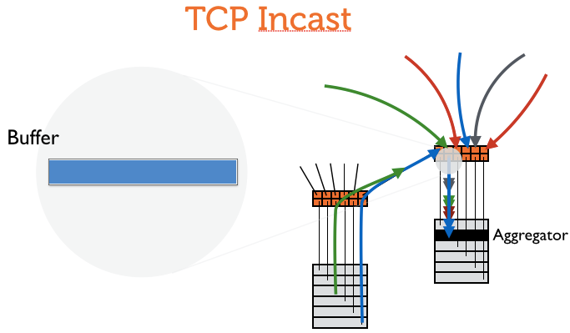
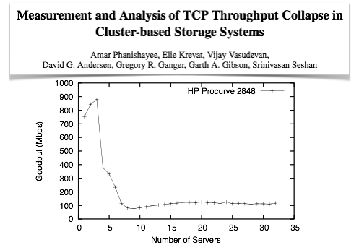
Dealing with TCP Incast
Notes:
Next, let’s talk about TCP incast. We discussed incast in our lesson on congestion control, but briefly … incast is a situation where a large number of senders send data to a network port, which overwhelms the buffer, leading to high packet loss and latency. Further, if some TCP flows lose many packets, they can time out, and TCP throughput can collapse. In our congestion control lesson, we saw how DCTCP helps address the problem, but what can one achieve at the application layer?

Slide 16
Dealing with TCP Incast
Limit the size of individual responses
Ignore a late response from a worker
Deliberately space out requests and responses
Notes:
One way of reducing the likelihood of incast scenarios, is to limit the size of responses sent by individual workers in the application. If each sender only sends a packet or two, perhaps the buffer will accommodate a large number of senders without any packet drops. Of course, this is a rather severe restriction on the application, and is not a general-purpose solution.
Another way is to accept that some workers’ responses may be dropped in the occasional incast scenario, and structure the application to deliver partial results. Again, this is a rather undesirable non-solution.
A more workable approach is to deliberately space out the application’s requests and responses. The application can add small delays between successive requests, ensuring that the responses also have greater variations in their arrival times, thereby making incast less likely. This technique has been used in some systems. Of course, the downside is that by adding these deliberate delays to avoid incast and high tail latencies, it increases the average response time.

Slide 17
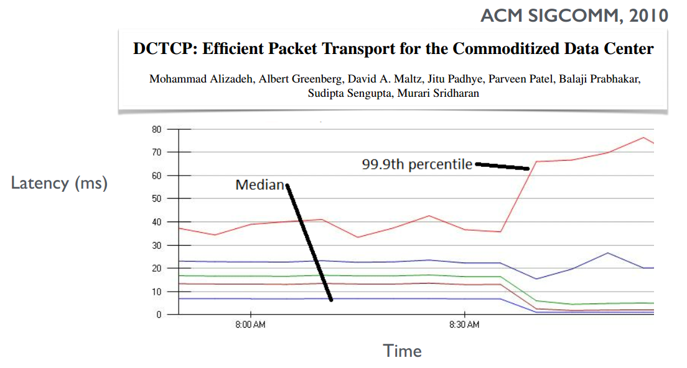
Spacing out requests / responses
After “request jittering” is turned off
Notes:
The DCTCP paper itself notes the use of this approach in production data centers. This plot shows the impact of disabling this technique — referred to as “request jittering” in the paper. Each line on the plot is a different latency percentile — the lowest, in blue, under 10ms, is the median latency, and the largest is the 99.9th percentile latency. After request jittering is turned off, the 99.9the percentile doubles, while the lower percentiles decrease. This illustrates the compromise this approach presents: sacrificing some performance in the common cases for a decrease in incast scenarios.
Facebook has also reported the use of a technique that’s similar in essence, in its memcached deployment.

Slide 18
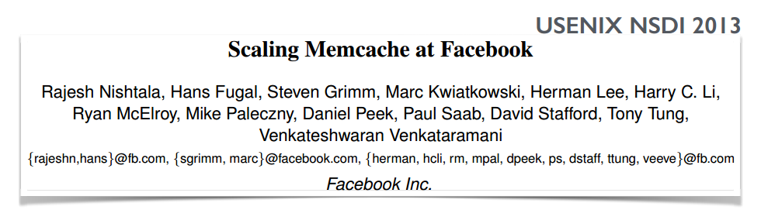
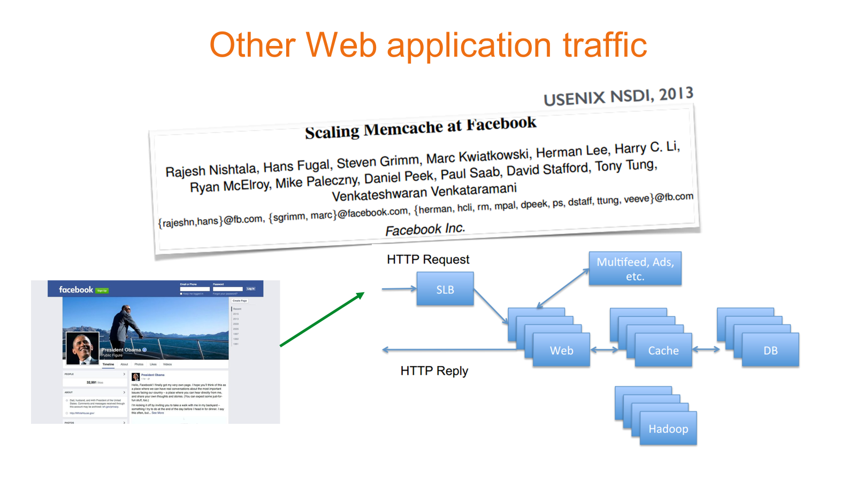
Dealing with TCP Incast
Outstanding requests
All requests queued at a client
TCP-like flow-control across requests
Notes:
Their mechanism involves controlling the number of outstanding memcache requests using a sliding window, in a manner similar to how TCP controls the flow of packets for a single connection. So, a client maintains a window of outstanding requests, for which this client is awaiting memcache responses. When some responses arrive, the window advances and grows in size. But when some responses time out, the window shrinks.
This is essentially another layer of flow control on top of TCP’s. This rate limiting works across different connections unlike TCP’s!
When the window is too small, requests wait long to be scheduled. When it’s too large: there is a risk of incast, leading to slower processing.

Slide 19
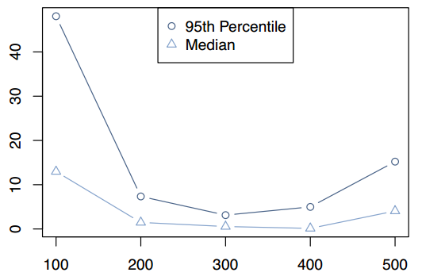
Dealing with TCP Incast
UDP for GET requests: 0.25% failure rate but lower latency and connection-less operation
Wait time before request is scheduled (ms)
Window size
Notes:
The paper includes measurements of the impact of the window size. In this plot, window size is on the x-axis, and the time requests wait at a client before being scheduled is on the y-axis. This data was gathered from multiple racks in one front-end cluster in Facebook’s network.
When the window is too small, requests wait long to be scheduled, and when it’s too large, it causes incast and slower processing of requests, leading to a buildup of requests. There’s a sweet-spot in the middle that minimizes wait time.
That closes our discussion of application-layer mitigation of incast. But it’s also worth noting that this paper highlights another interesting choice to extract higher performance: the use of UDP for GET requests where occasional failures are acceptable. This does mean a small failure rate because UDP does not provide reliable delivery like TCP, but the upside is lower latency because UDP doesn’t need connection establishment and slow-start. Also being connectionless, UDP doesn’t requires the server to maintain state, unlike TCP, thus using fewer resources on the servers. For things that change the data’s state, they still use TCP, for the reliability.

Slide 20
A few examples in this lesson …
1
Redundant requests to lower tail latency
2
Application layer handling of TCP incast
3
Rate adaptation for video streaming
Notes:
We’ll talk about how applications can deal with latency in the tail.
How TCP incast can be handled, although with some compromises, at the application layer
and how video streaming deals with variations in network capacity.

Slide 21


We want the highest video quality
(c) copyright 2008, Blender Foundation / www.bigbuckbunny.org, CC-BY-3.0
Notes:
Obviously, we’d like the highest possible video resolution … but we would like to avoid …

Slide 22
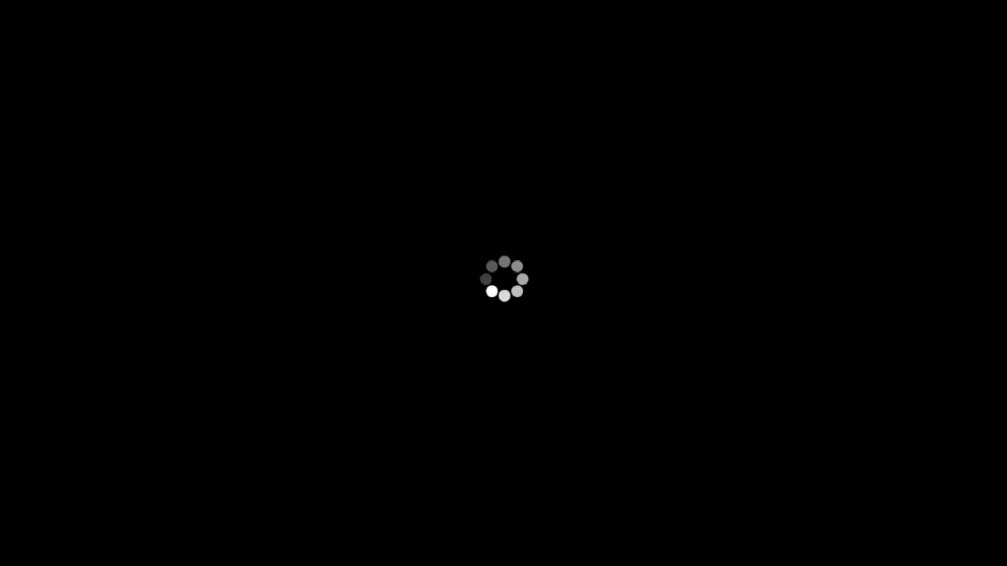
Without seeing this …
Notes:
… waiting for buffering. Buffering does help a lot — it can mask variations in the network’s bandwidth. In fact, even interactive applications like Skype use buffering on the order of a 100ms. For streaming video applications, several seconds of buffering is seen as acceptable because these aren’t interactive. You fill up the buffer in the beginning, start playing smoothly, and then the buffer covers up the variations in the network — when available bandwidth reduces, the buffer begins to drain, and when bandwidth increases, the buffer recovers. But occurrences of rebuffering due to the buffer completely draining out, after the playback starts cause a wait, and hamper user experience.
Helps
Skype
streaming video —> acceptable
Fill buffer in beginning, start playing, cover variations, …

Slide 23
Common solution approach
Encode video in multiple bit-rates
Estimate connection’s available bandwidth
Pick a video rate ≤ available bandwidth
Notes:
The common approach to solving this problem is as follows:
video is encoded in multiple bit-rates, for example from low resolution standard definition or SD through various rates up to 1024HD.
the video player at the client estimates the network connection’s available bandwidth
it then picks a video bit-rate less than that available bandwidth, so the rate of incoming data over the network exceeds the rate of data playing out of the buffer onto the client’s screen.
Simple enough, right? Let’s look closer at how this is supposed to play out …

Slide 24
Capacity estimation
Capacity (Mbps)
Time
Network
Buffer
Notes:
You’re looking at the video buffer at the client’s device here. We’ll see how the video bitrate is supposed to vary with the network’s capacity.

Slide 25
Capacity estimation
Capacity (Mbps)
Time
Network
Playing out
Downloading
1s
1s chunks at
different bit-rates
Capacity < current rate ⇒ decrease rate
Notes:
One can think of the buffer as a set of 1s chunks. The 1s chunks at high bit-rates like HD are obviously a larger number of bytes and use more room in the buffer, and are thus shown as taller.
The chunk at the head of the buffer is playing out to the screen, and a new chunk is downloading into the buffer.
The plot above the buffer is shown as a track of the network bandwidth. Bandwidth is measured over the download of the chunks — if a chunk is 2 Mb and took 1 second to download, the bandwidth measured is 2Mbps. This measured bandwidth may be used as an estimate of the future network capacity. If this estimated capacity is less than the video rate, we need to request the next chunk at a lower quality or bitrate. An easy way to think about this is: if you’re taking more than 1 second to download the chunk that plays in 1 second, you need to request chunks at reduced video quality. And of course, if the capacity estimate is higher than the video rate, we may be able to jump to a higher quality chunk, etc.
This general technique is called Adaptive bitrate streaming. One cool thing to notice: the rate selection logic resides at the client, so the CDN server-side logic is pretty simple. This works reasonably well, and at least until recently, some variant of this was Netflix’s default approach. But there is room for improvement!

Slide 26
Issue
Encode video in multiple bit-rates
Estimate connection’s available bandwidth
Pick a video rate ≤ available bandwidth
Notes:
The problem is that capacity estimation is hard to get right. If your estimate is too conservative, you unnecessarily use a low quality stream; if your estimate is too aggressive: you request higher quality chunks, and the buffer drains out because of the time it takes to get those chunks, and this causes the video to pause. This pause is called a “rebuffer”. (We’ll refer to this term, “rebuffer” often in the following discussion.)

Slide 27
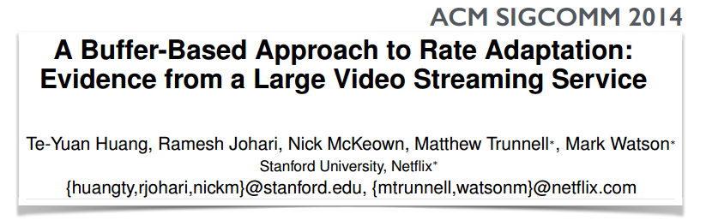
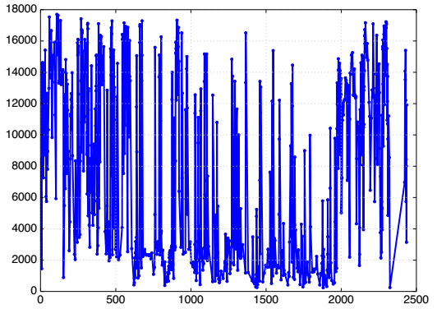
Estimating available capacity
“A random sample of 300,000 Netflix sessions shows that roughly 10% of sessions experience a median throughput less than half of the 95th percentile throughput.”
Avg. throughput over chunk download (kbps)
“20–30% of rebuffers are unnecessary”
Time(s)
Notes:
The difficulty of estimating network capacity is reflected in this plot. It shows for one Netflix video player trace, the average throughput over chunk downloads (on the y-axis) over time (on the x-axis). Notice how the average throughput varies in a wide range. 10% of sessions in a random sample of 300000 Netflix sessions show high variability in the network capacity.
This variability means that capacity estimation is often off the mark: 20-30% of all rebuffers seen in this dataset were found to be avoidable — i.e. switching to a lower video rate would have avoided the need to pause. (Of course, if the network’s capacity is lower than lowest video bit-rate, then nothing can prevent frequent rebuffering.) This paper from Stanford and Netflix researchers, thus proposes a method of improving upon the capacity estimation based approach.

Slide 28
Capacity estimation
Capacity (Mbps)
Time
Network
Decide based on the buffer alone?
Capacity < current rate ⇒ decrease rate
Notes:
The key idea of this work is this: it’s the buffer’s occupancy that we care about; can we make decisions based on the buffer occupancy alone? The short answer is “for the most part”.

Slide 29
Buffer-based adaptation
Network
Nearly full buffer ⇒ large rate
Notes:
If the buffer if nearly full, we can use a larger bitrate i.e. higher quality video.

Slide 30
Buffer-based adaptation
Network
Nearly empty buffer ⇒ small rate
Notes:
If the buffer if nearly empty, we need to be using lower bitrate i.e. lower quality video if we want to avoid rebuffering.

Slide 31
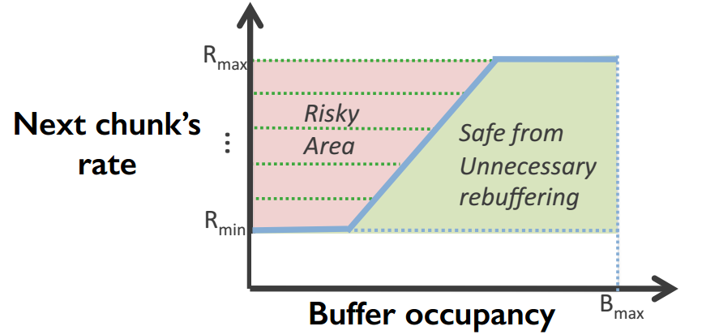

Buffer-based adaptation
High buffer:
use Rmax
Low buffer:
use Rmin
Notes:
This intuition can be captured formally as a function that maps buffer occupancy to the next video chunk’s bitrate. If the buffer occupancy is high, we can use request the highest quality video, if it’s low, we must request the lowest quality video. This ensures that as long as network capacity exceeds the lowest video bitrate, the video stream will not suffer from a rebuffer. Between these extremes, the chunk rate is a non-decreasing function of buffer occupancy — it’s not necessarily linear though, that’s just the example here. We will omit here the details of the functions explored in this work. But nevertheless, one problem remains …

Slide 32
Problem: startup phase?
Pick a rate based on immediate past throughput
Notes:
… what about the startup phase? When the stream has just started, the buffer occupancy gives us very little information. How do we make decisions then? A simple form of capacity estimation based on immediate past throughput is indeed useful during this startup phase.
Note that reality is a bit more complex than what we discussed here: for example, video encoding rates aren’t continuous but discrete — so you might have a few options between the lowest and highest rates, so you need to figure out how to discretize the rate function. The paper addresses these issues if you’re interested.
How well does this approach work? The paper includes results from real-world experiments at massive scale: data was gathered from 500,000 users of the Netflix browser-based player over a weekend in Sept. 2013. Each group in their A/B tests played roughly 120k hours of video. Let’s look at the two primary quantities of interest: number of rebuffers and video quality.

Slide 33
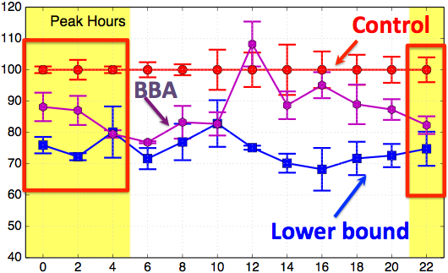
Buffer-based adaptation
Normalized number of rebuffers per hour (%)
Hours in GMT
Notes:
The x-axis of this plot is time in GMT. The yellow bands represent peak Netflix hours in the US. The y-axis is the number of rebuffers normalized to the number of rebuffers in the control algorithm — which is Netflix’s capacity estimation based rate approach in deployment at the time of these experiments. The lower bound curve shows the best possible result for rebuffers — if the video were played at the lowest quality throughout, what would the number of rebuffers be. This result simply indicates that there’s roughly 20-30% room for improvement in the best case. The buffer based adaptation algorithm marked BBA achieves performance quite similar to the lower bound algorithm in the peak hours. It achieves 10-20% fewer rebuffers than the control algorithm!
Further, the buffer-based algorithm, unlike the lower-bound in this plot, does not compromise on video quality. This is what the other result we’ll discuss shows.

Slide 34
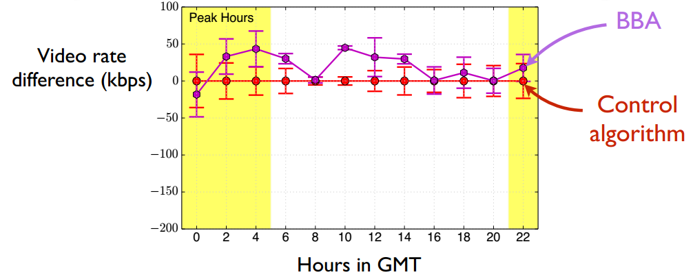
Buffer-based adaptation
Notes:
Here the y-axis is the video rate difference between the default / control algorithm, and BBA. BBA achieves higher video rate.
Keep in mind that this algorithm is deployed in the browser-based player on top of standard protocols. In such applications, where there’s enough value, there is a strong argument for the application to take on some of the tasks that the general-purpose network isn’t necessarily adept at.

Slide 35


Neural Adaptive Video Streaming with Pensieve
Hongzi Mao
Ravi Netravali Mohammad Alizadeh
Notes:
I’m going to talk about neural adaptive video streaming with Pensieve. This is a joint work with Ravi and Mohammad from MIT.

Slide 36


Users start leaving if video doesn’t play in 2 seconds
https://gigaom.com/2012/11/09/online-viewers-start-leaving-if-video-doesnt-play-in-2-seconds-says-study/
Video: La Luna (Pixar 2011)
Notes:
When we stream a video from the internet, we all have this annoying experience -- the video suddenly gets stuck and starts rebuffering ..
Studies actually show that users start leaving if the video doesn’t play in 2 seconds.
And given that fact that video streaming has been dominating today's internet traffic, this kind of bad experience will lead to tremendous loss of users. Therefore industry and academia have devoted lots efforts to improve video streaming experience.

Slide 37
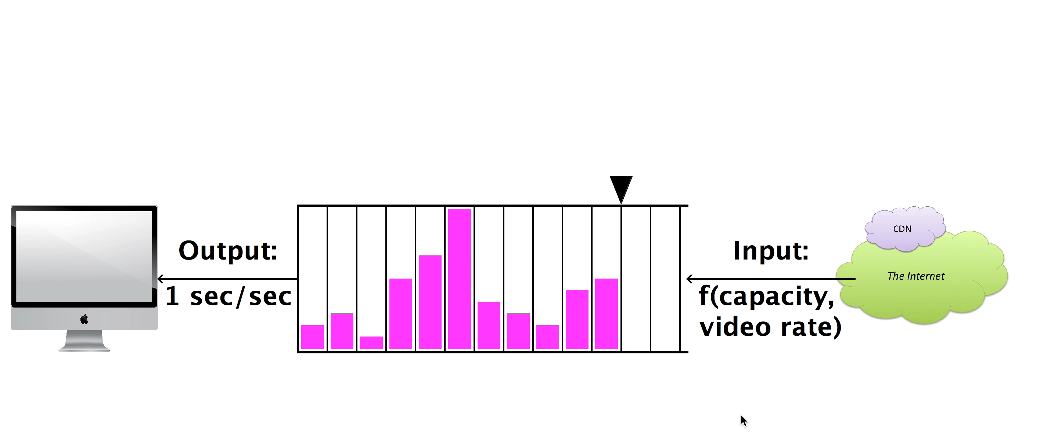



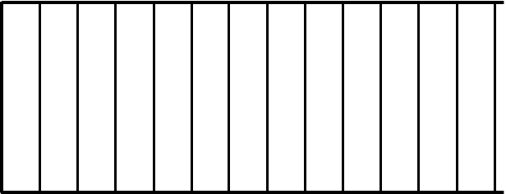

Dynamic Streaming over HTTP (DASH)
Request:
next video chunk at bitrate r
Output
1 sec/sec
Input
Response:
video content
bitrate
1 sec
video
content
Video Client
Video Server
Adaptive Bitrate (ABR)
Algorithms
bitrate
Animation borrowed from Te-Yuan Huang (SIGCOMM ‘14) http://conferences.sigcomm.org/sigcomm/2014/doc/slides/38.pdf
Notes:
The main framework to improve the quality of experience is dynamic streaming over HTTP or DASH. It's a very standard framework and I will give an overview of how it works.
To load a video, a video client periodically requests individual chunk of video from a video server. Each chunk represents several seconds of video and can be requested at one of several bitrates. As the video chunks are downloaded, they are stored in a playback buffer. In this abstract figure, each pink bar represents a video chunk in the buffer. The width of the bar is 1 second of the video and the height indicates the bitrate. The higher bitrate corresponds to higher resolution or higher quality of the video.
As the video is playing, the playback buffer is continually drained at a fixed rate since the user watches videos in ‘real time’, but the buffer will be populated at a variable rate, depending on the requested bitrate and network condition.
[play video]
This can become problematic if the chunks we request have higher bitrates than the network can support, therefore chunks are being drained faster than they are enqueued -- this ultimately leads to an empty buffer and thus a rebuffering period.
To prevent issues like this, video players use Adaptive Bitrate Algorithms, or ABR algorithms. These algorithms decide both when and at which bitrate to download each video chunk.
[click] Specifically, these algorithms choose among a few available bitrates adaptively depending on the network and playback buffer condition.
Because of that, these algorithms have a large impact on quality of experience.

Slide 38
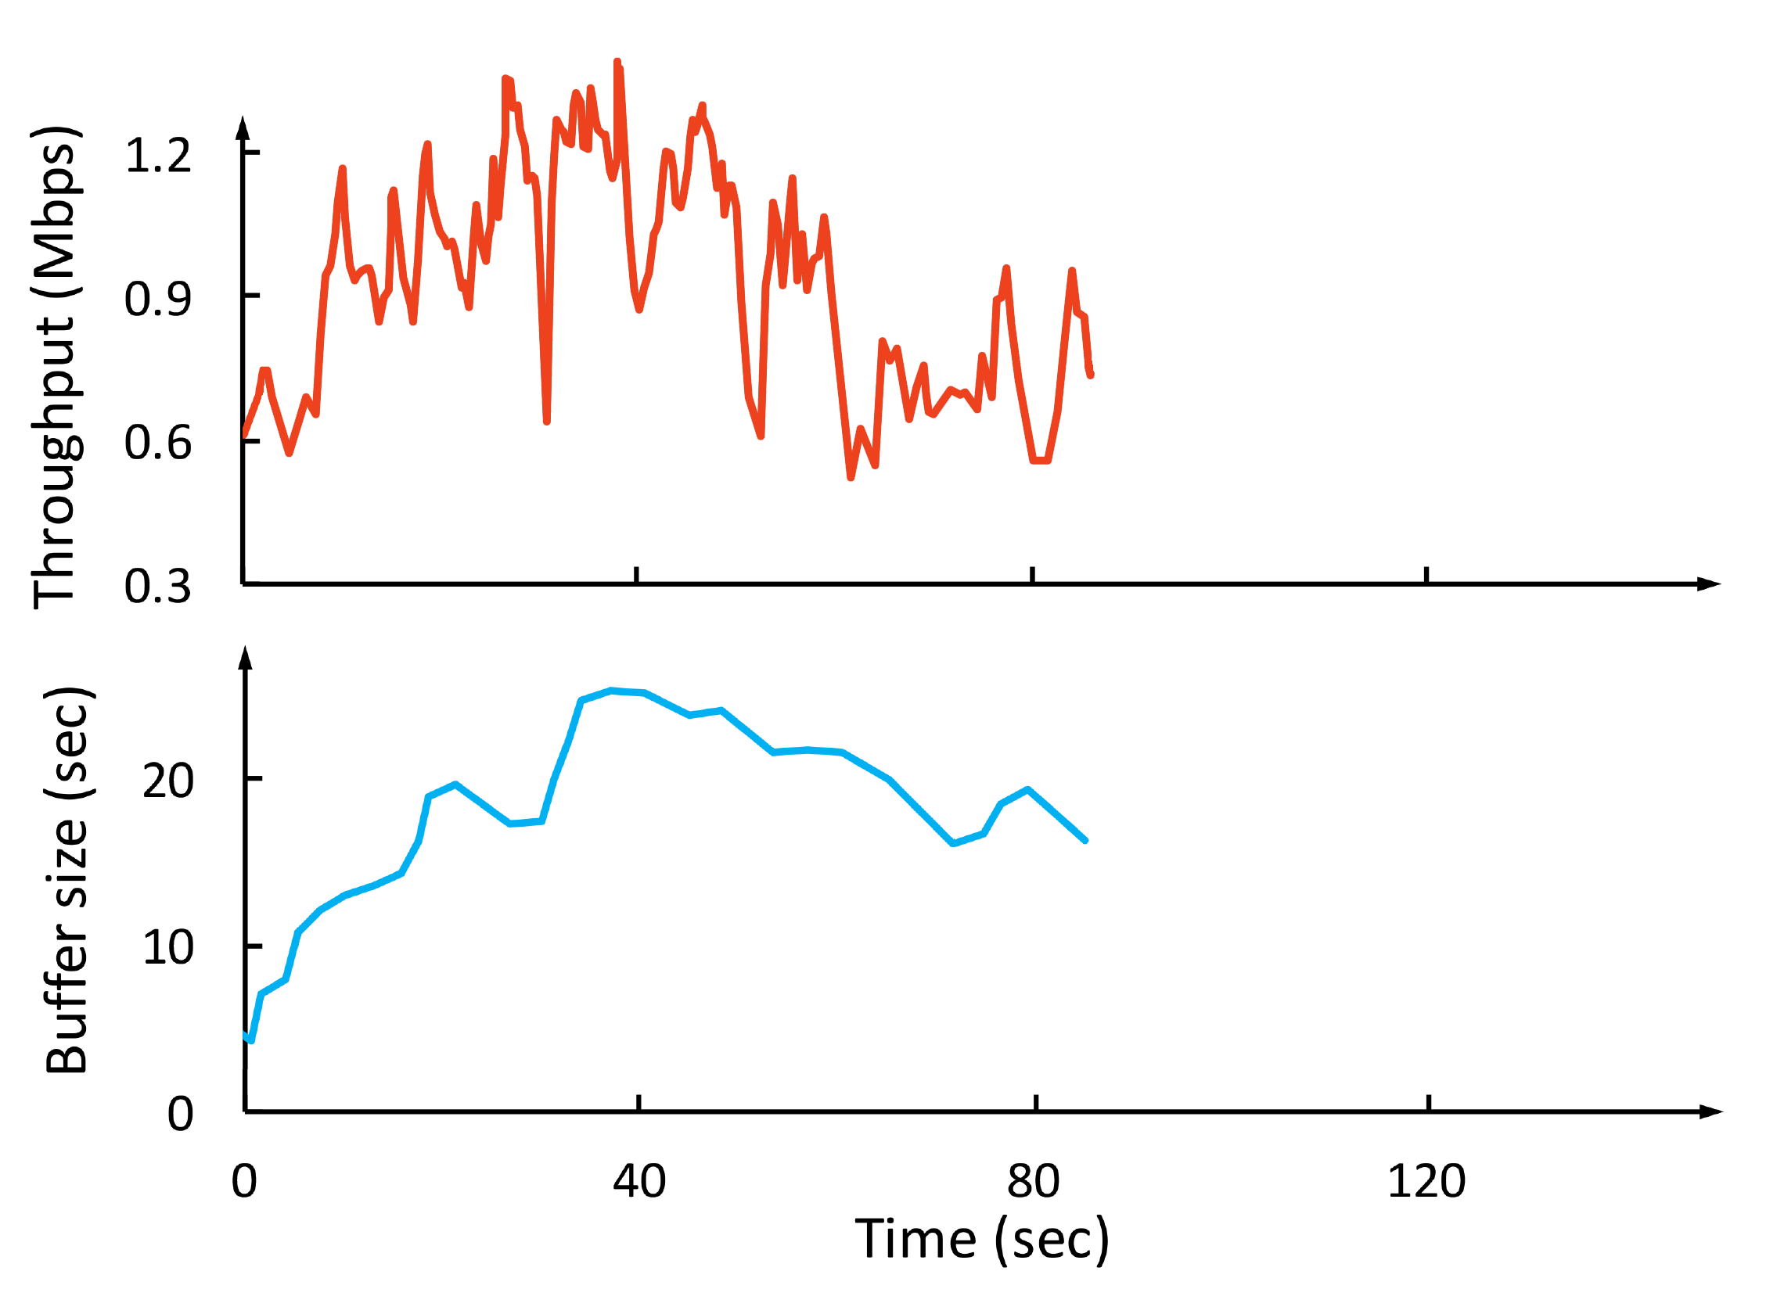
Why is ABR Challenging?
Throughput
Network throughput is variable & uncertain
Throughput
Bitrate
(Mbps)
Conflicting QoE goals
Bitrate
Rebuffering time
Smoothness
Video bitrate
Buffer size
(sec)
Cascading effects of decisions
Notes:
With this context, now let’s look at why designing ABR algorithms is so challenging? Let me use this example. Say we have streamed a video for a while..
Now at this point, how would the future throughput look like? it go higher, or it could could remain steady for a while and then drop, in fact it can be one of the many many possibilities -- past throughput observations cannot accurately predict what will happen exactly . It’s very challenging to select a bitrate that adapt to this noisy cloud of future possibilities.
Next, in practice, there’s tension and tradeoff among multiple conflicting QoE goals. People don't simply just want higher quality, they don't want rebuffering, and no bitrate fluctuations. However, selecting higher bitrates could result in rebuffering if there’s no enough playback buffer.
Finally, the bitrate decision for the next chunk can affect the decisions in the future. For example, using a high bitrate at the current time may deplete the video buffer, which leaves little cushion to deak with the risk rebuffering in case of network fluctuations. So, ABR algorithms must plan for the future.

Slide 39

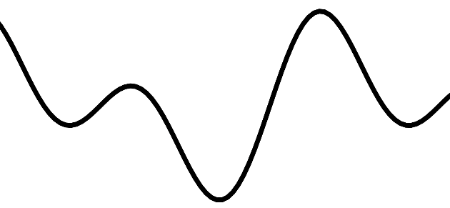

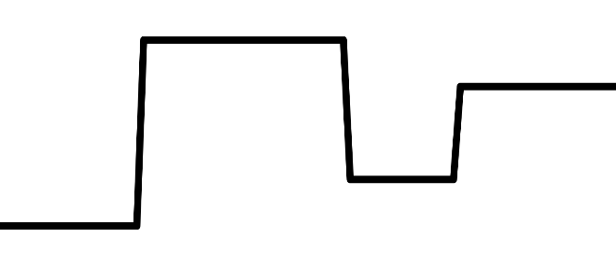

Our Contribution: Pensieve
bandwidth
ABR agent
bitrates
240P
bit rate
480P
720P
buffer
720P
1080P
First network control system using modern “deep” reinforcement learning
Delivers 12-25% better QoE, with 10-30% less rebuffering than previous ABR algorithms
Tailors ABR decisions for different network conditions in a data-driven way
network and video measurements
Pensieve learns ABR algorithm automatically through experience
Notes:
In this work, we built Pensieve, a system that uses reinforcement learning to learn an ABR algorithm automatically through experience. Pensieve represents the ABR algorithm as a neural network, that takes as input the observation from video client and output the bitrate decision for the next video chunk. It trains this neural network using data from a large number of video streaming sessions in actual network conditions.
[Click]
Our contribution with Pensieve, is that, to our knowledge, this is a first network control system that uses modern "deep" reinforcement learning techniques.
It outperforms existing ABR algorithms substantially, improving the quality of experience by 12-25%, with 10-30% less rebuffering over the best previous schemes in realistic network conditions.
We found that Pensieve is able to achieve this performance fundamentally because it learns rules for ABR that are specifically tailored for the underlining network characteristics.
Further, in building Pensieve, we learned several lessons about using deep reinforcement learning for network control systems. We believe these techniques are very powerful and can be applied to many other such problems, therefore I will share a few lessons that we learned near the end of this talk.

Slide 40
Previous Fixed ABR Algorithms
Rate-based: pick bitrate based on predicted throughput
FESTIVE [CoNEXT’12], PANDA [JSAC’14], CS2P [SIGCOMM’16]
Buffer-based: pick bitrate based on buffer occupancy
BBA [SIGCOMM’14], BOLA [INFOCOM’16]
Hybrid: use both throughput prediction & buffer occupancy
PBA [HotMobile’15], MPC [SIGCOMM’15]
Simplified inaccurate model leads to suboptimal performance
Notes:
Before we talk about Pensieve, let's first look at previous schemes. All existing develop fixed rules in the ABR algorithms based on human insights.
For example, there are algorithms using throughput prediction; there are some others determining the bitrates based on the buffer occupancy. Each of these schemes doesn't use all the available information.
Therefore more sophisticated methods have been proposed to combine both signals. For example MPC, the state of the art approach from SIGCOMM 2015.
However, as I mentioned, all these schemes use fixed heuristics based on designer’s insight. The problem with these approaches [click] is that they rely on simplified inaccurate models to come up with their algorithms, as I will show, this can lead to suboptimal performance under actual network conditions.

Slide 41
Example: Model Predictive Control
Solution: learn from video streaming sessions
in actual network conditions
t
t + T
Throughput
maximize QoE (t, t + T)
subject to system dynamics
Throughput
Bitrate
(Mbps)
Conservative Throughput
Prediction
Video bitrate
Buffer size
(sec)
Problem: Needs accurate throughput model
Notes:
Let me give you an example using the MPC scheme that I just mentioned. MPC uses a framework called Model Predictive Control, what it does is it looks ahead in a future horizon and solves an optimization problem. It maximizes the QoE objective over the future horizon, subject to the system dynamic. Then it picks first step of the solution as the next bitrate decision.
[click] The problem with this approach is that it needs an accurate model for network throughput. To express the optimization problem, we need to plug in some model for how future throughput would evolve. But as I explained, [click] we can’t really predict the future network trajectory. And therefore what practical schemes end up with doing is they rely on a simplified estimate of throughput, such as average throughput or conservative throughput estimation. But such heuristics are hard to get right in real networks and can lead to suboptimal decisions.
-
To overcome the issues with today's fixed ABR algorithms, we turn to design a general purposed learning algorithm. Specifically, we are proposing to learn bitrate adaptation policies, by interacting with the video streaming environment in actual network conditions
--
short future horizon -> unclear how to set the length of future horizon / fixed opt horizon, the designer is forced to design the length, if it's too long, too short.. (might drop this point)
Add a banner, solution: learn the model from actual video streaming session

Slide 42
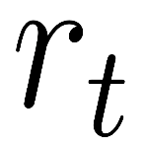
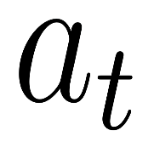
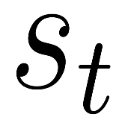
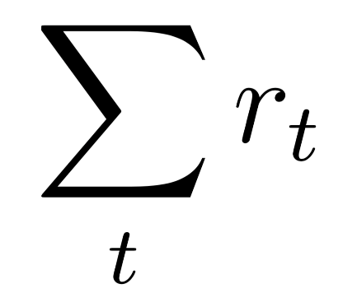
Reinforcement Learning
Reward
Agent
Environment
Take action
Observe state
Goal: maximize the cumulative reward
Notes:
[…], using Reinforcement Learning.
Let me first give you an overview of reinforcement learning
Reinforcement Learning poses a general framework, where an agent interacts with an environment. At each time step, the agent observes a state from the environment, and takes an action. As a feedback, the environment returns the agent a reward signal, indicating how good the action is. The goal of the learning agent is to maximize the total reward in the environment.
-
[…] = To overcome the issues with today's fixed ABR algorithms, we turn to design a general purposed learning algorithm. Specifically, we are proposing to learn bitrate adaptation policies, by interacting with the video streaming environment in actual network conditions

Slide 43

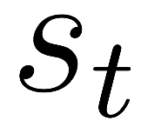
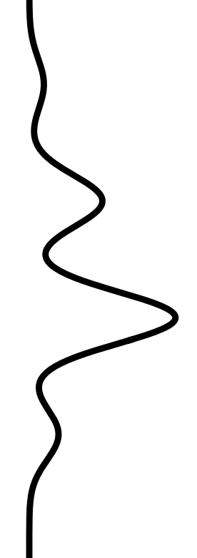

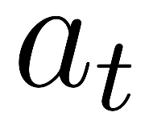
Pensieve Design
Reward
Reward r_{t}
State
Agent
$$+ q\left(b_{t}\right)−μT_{t}−λ\left|q\left(b_{t}\right)−q\left(b_{t−1}\right)\right|$$
+ (bitrate) - (rebuffering) - (smoothness)
240P
Environment
Action a_{t}
360P
Action
720P
720P
1080P
Notes:
Following the reinforcement learning framework, this is how we build the learning system for bit rate adaptation. Here the environment would be video steaming application on top a network.
To explain Pensieve's design, I need to tell you what's the state space, what's the action space and what's the reward signal.
Let's start with the state space.
The state space needs to include all the information that's relevant to make bitrate decisions. So what are these?
The first thing is throughput observation [click]. we have a sequence of throughput measurements, and the time interval of these samples. These observations are collected when past chunks are downloaded.
Next, we provided the actual file size for different bitrates of the next chunk. This is useful because the chunk sizes for different bitrates can vary across videos and even across chunks in the same video, depending on the complexity of the video frame.
Also we show the agent the playback buffer occupancy.
And we gave the agent the number chunks until the end as well. If you think about this problem, it’s finite horizon control problem. Towards the end of video playing, maintaining a large buffer doesn’t buy you too much. The bitrate selection policy towards the end can be more aggressive. And this term reflects how safe it is to be aggressive.
The last thing is the current bitrate. The agent needs to know what bitrate it’s currently at, to control the smoothness of the video.
Next, the action space. The action to take would be the bitrate for the the next chunk.
Then, as the feedback, the reward signal can be derived directly from the QoE metric, which considers the 3 QoE factors that I described earlier: bitrate, rebuffering, smoothness. Specifically, we want the quality to be higher, so positive reward. We don't want rebuffering or bitrate fluctuations, so give penalty whenever the video rebuffers or bitrate gets changed. The mu and lambda are balancing factors, which can be customized for different preference.
Now there's an neural network that maps the raw state input to the probability distribution of next bitrate. This neural network encodes the bitrate adaptation policy.
The internal architecture of the neural network has has 2 hidden layers, and it has 1D convolutional networks, which process the three sequential inputs. The entire neural network has roughly 80,000 parameters.
--
Remove the text when nn shows up

Slide 44
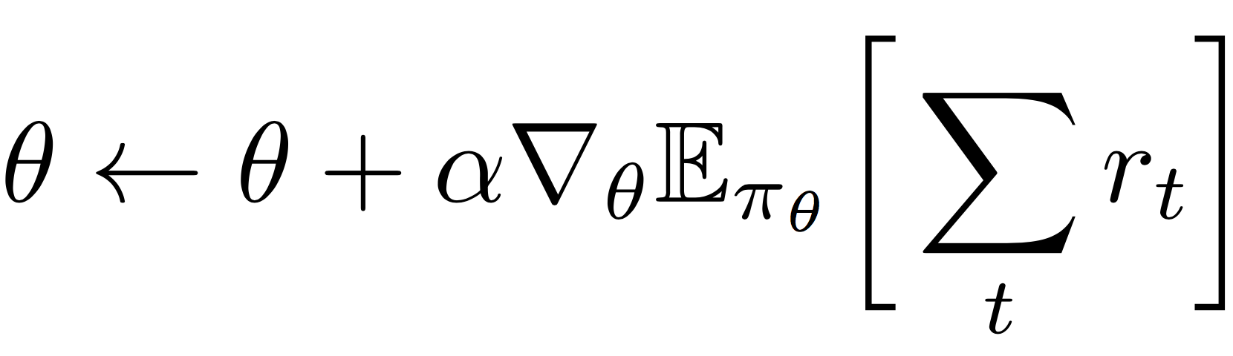
How to Train the ABR Agent
ABR agent
policy
π_{θ}(s, a)
Neural Network
240P
state
Observe state s
480P
Take action a
next bitrate
720P
1080P
parameter θ
Collect experience data: trajectory of [state, action, reward]
Training:
estimate from
empirical data
Notes:
Now how do we train the neural network? Or in other words, how do we improve the bitrate adaptation policy?
[click]
The key idea is you run the system, you collect experience data, which is the trajectory of state, action and reward: what state did I visited, what action did I take and what reward did I receive.
To train, we basically use gradient descent to move the neural network parameters in a direction that can increase the reward.
[click]
Remember, the goal is to maximize total reward, we can take the gradient of the total reward and move the neural net parameter in the direction of the gradient.
[click] In practice, the gradient of total reward can be estimated empirically from the experience data.
The details of this math and the specific algorithm is in the paper, but the key take away is that we train the neural network essentially through a guided process of trial and error, exploring different actions and learning what actions provide better reward.

Slide 45
What Pensieve is good at
Learn the dynamics directly from experience
Optimize the high level QoE objective end-to-end
Extract control rules from raw high-dimensional signals
Notes:
At a high level, there are some nice properties of this Reinforcement Learning framework that fit exactly for the bitrate adaptation problem.
First, unlike the heuristics based methods, the learning approach can adapt faithfully to the underlining characteristics of the network in a data-driven way. For example, after seeing many many examples in the cellular network, it will figure out quantitatively how much buffer it needs to build to cope for uncertainty in the nature of the network.
Also, the framework allows you to optimize for a high level QoE metric end-to-end, without having to explicitly model how it is impacted by low level decisions. We can optimize for any arbitrary QoE metric as long as we can represent it through the reward signal.
In addition, you can learn an ABR algorithm that takes as input raw high-dimensional signals, like the sequence of throughput samples, and extract useful information out of it. That's from the power of the underlining neural network.

Slide 46





Pensieve Training System
Large corpus of
network traces
cellular, broadband, synthetic
Video playback
Fast chunk-level simulator
Model update
TensorFlow
Pensieve worker
{state, action, reward}
experiences
Pensieve worker
Pensieve master
updated neural
network parameters
Pensieve worker
Notes:
Now in our actual implementation, we built a parallel training system to speed up the training process.
We first collect large corpus of network traces from various datasets.
Using these traces, we have multiple workers that simulate the video streaming session over randomly sampled network traces.
These parallel workers collect experience in the form of [state, action, reward] and communicate with a master.
The master will compute the gradient using the method I described, and periodically update the neural net parameters, and send them back to the workers.
The training will continue for roughly 10,000 video streaming sessions, until the bitrate adaptation policy converges.

Slide 47
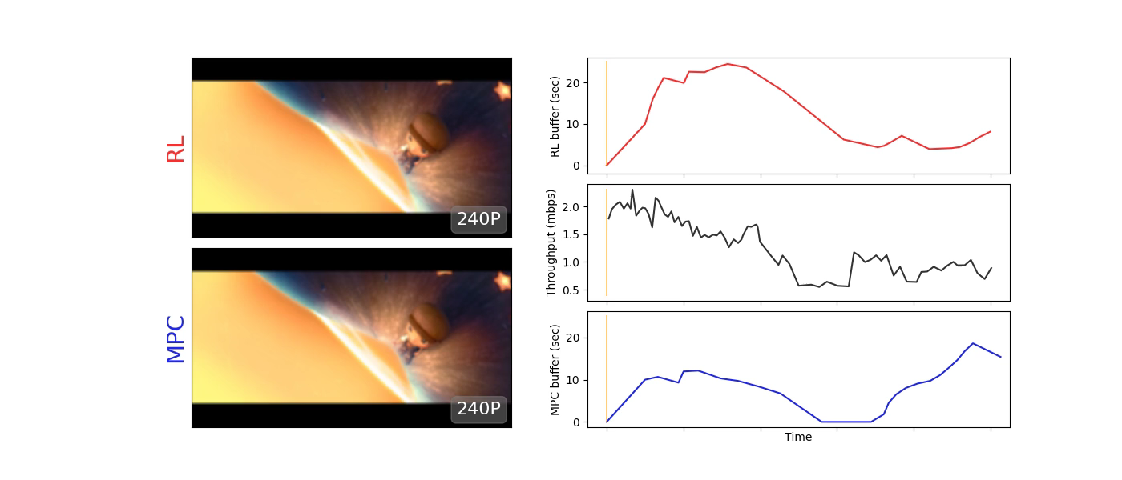
Demo
Pensieve buffer (sec)
Pensieve
chances of outage
Throughput (mbps)
Rebuffering
MPC
MPC
buffer (sec)
Notes:
Now let me show you a quick demo of Pensieve.
Pensieve is shown on the top and the state-of-the-art comparing scheme robustMPC is shown on the bottom.
The black curve shows the network throughput, you can see the inherent variability and [click] some chances of outages in the network. A good bitrate adaptation policy for this network, should strategically maintain some amount of buffer to deal with the risk of sudden degradation of network throughput.
The buffer occupancy of the two schemes are also plotted.
(Play video)
In the beginning, the network throughput is relatively stable. Since MPC only considers current and local throughput conditions, it quickly shifts to a higher bit rate. Pensieve however, has observed from many many such network examples, that understand there's a chance of outage. Therefore it plays more cautiously and builds up its buffer.
Now the network comes to an outage period, and MPC wouldn’t have any buffer to play and it suffers from severe rebuffering. Pensieve however, have enough cushion and can gracefully shift to lower bitrate without stopping.
This little example shows that Pensieve has a way to understand the underlining characteristic of this network.

Slide 48
Trace-driven Evaluation
Dataset: Two datasets, each dataset consists of 1000 traces, each trace 320 seconds.
Video: 193 seconds. encoded at bitrates: {300, 750, 1200, 1850, 2850, 4300} kbps.
Video player: Google Chrome browser Video server: Apache server
Norway 3G cellular dataset
FCC broadband dataset
better
better
Pensieve improves the best previous scheme by 12-25%
and is within 9-14% of the offline optimal
Notes:
Now I will show you a wide range of experiments that we did.
We did our actual comparison with other schemes using real network traces, a 3G cellular network and a broadband network. Each dataset has 1000 traces, each about 300 seconds long. The video we tested is around 200 seconds long, and is ecnoded in 6 bitrates. We put the video server in a apache server, and a DASH video client in a google chrome browser.
Here are the the CDF of QoE of the existing schemes. This QoE objective considers bitrates, rebuffering and smoothness.
And this is what Pensieve achieves.
We can also obtain an offline optimal using dynamic programming. Offline optimal serves as an upper bound to any scheme with perfect information about future network throughput, which is not practical. Nontheless, Pensieve is still very close to the offline optimal.
Overall, Pensieve improves the average QoE by 12-25% over the best previous scheme, and only within 9-14% to the offline optimal.

Slide 49

QoE Breakdown
better
better
better
Pensieve reduces rebuffering by 10-32% over second best algorithm
Reward/QoE
+ Bitrate utility – rebuffering penalty – smooth penalty
Notes:
Dig a bit deeper, we can actually breakdown [click] each term in the QoE objective and see how each scheme performs.
[click]
This shows more clearly where Pensieve wins.
Notice that Pensieve is not outperforming existing schemes in every dimension. But Pensieve is able to achieve the best collective QoE by balancing different conflicting factors.
Pensieve achieve similar average bitrate as other schemes, [click] but reduces rebuffering by 10-30% compared with the second best scheme.

Slide 50
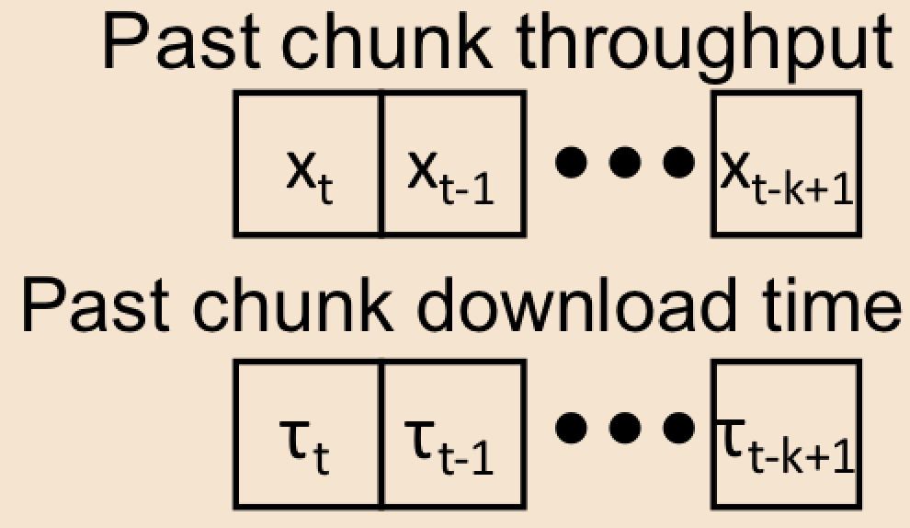
Lessons We Learned
1. Build a fast experimentation/simulation platform
2. Data diversity is more important than “accuracy”
3. Think carefully about controller state space (observation signals)
Too large a state space ⟶ slow & difficult learning
Too small a state space ⟶ loss of information
⟶ When in doubt, include rather than cut the signal
Coarse-grain chunk simulator
Pensieve agent
Notes:
Pensieve is one of the first network systems that uses the cutting edge reinforcement learning techniques. These technqiues can be applied to many other networking control problems as well. Here we just want to share a few lessons we learned over the course of developing Pensieve.
First, this kind of deep reinforcement learning techniques need a large amount of data, therefore the training of the agent is often bottlenecked by the ability to perform experiment or simulation quickly. The first thing you want is to build a very fast experimentation/simulation platform. For example, although Pensieve can be trained on real video streaming session, [click] we chose to train it with simple but fast simulator that operates at the level of video chunk. It doesn't model the network packet, it doesn't model TCP. But it's super fast, it can replay many days of video in the matter of minutes.
Next, when training these deep reinforcement learning models, data diversity helps. You want the learning agent to experience very diverse mix of network conditions. From a a statistical learning perspective, training with more varied input examples is actually a good thing for the learning algorithms to generalize. In fact, this is also why the coarse grained simulator is sufficient for Pensieve, we don’t have to have very high fidelity for any specific network trace, some noise actually helps the learning algorithm generalize.
And lastly, we need to think carefully about the design of controller state space.
There's a tradeoff between including more information in the state space and reducing the complexity of control policy. If the learning agent observes too much information, it makes the learning slow and difficult. If we confine the state space, that might lose some useful information from the environment. What we learned is, when in doubt, include rather than cut the signal. You don’t want to lose any little information that’s useful to make the control decisions. The underlining neural network is capable of extracting lots of mileage from this little but subtle information.
Let me give an example, if you remember, in our throughout representation, we include the download time of the chunk. [click] This might look strange, what we really need is throughput measurements, but reason we also include the download time is that it provides the time scale of the throughput measurements -- this is useful information, for example, the network throughput over a longer time scale is more stable than over a shorter time scale, this sequence of intervals lets you estimate the variance of the network. We found that if we omit this information, it actually hurts the performance by 2 to 3%.
So Pensieve can make use of all this kind of little information to make best decision for the next bitrate, through its experience of interacting with the environment.

Slide 51
Summary
Pensieve uses Reinforcement Learning to generate ABR algorithms
Pensieve optimizes different network conditions through experience
Pensieve outperforms existing approaches across a wide range of network environments and QoE preferences
Policies generated by Pensieve have strong ability to generalize
http://web.mit.edu/pensieve/
Notes:
As a summray, Pensieve is a system that uses reinforcement learning to genreate ABR algorithms. It optimizes for different network conditions through experience. Pensieve outperforms state-of-the-art schemes in a wide range of settings. And it generalizes well even for the network conditions on which it is not explicitly trained.
More information and the open-sourced code can be found in our website.
With that, thank you and I’m happy to take questions

Slide 52
Summary of this topic
Applications need to cope with the network performance
Three example techniques:
1
Redundant requests to lower tail latency
2
Application layer handling of TCP incast
3
Rate adaptation for video streaming
Notes:
In a seminal paper dating back to 1981, Saltzer, Reed, and Clark made the end-to-end argument. Their point is best illustrated with an example. Consider an application whose function is reliable file transfer between two application end-points separated over a network. There are many sources of error possible: for instance, the network’s links or routing devices could drop some of the data or corrupt it, or the end host network stacks could have errors. One can try and eliminate all the possible known sources of error by careful engineering— this would not only be difficult and expensive to achieve, but could still leave out previously unknown sources of error. Thus, the application should itself check whether the data is correctly transferred or not — perhaps by a checksum; if the check fails, the application could retry the transfer. Of course, this is not to say that the network should be built to be lousy — the more reliable the network, the less likely that the end-to-end check will fail and the application will need to retry the file transfer. But ultimately, the responsibility for ensuring correctness of the data lies with the application. To quote Saltzer, Reed, and Clark: …
They also describe an instructive incident to drive this point home: An MIT networked system used hop-by-hop checksums over every network hop. But within one network gateway, there was a small rate of errors in copying the data from the input to the output buffers. In this case, the ultimate end-to-end check was required: manual comparison and correction of some of the data that had been transferred over that connection.
The lesson here is that ultimately, applications have to deal with network conditions to suit their objectives.
Now, certain functions are desired by a large number of applications, so we build them into lower layers. For example, reliable, in-order packet delivery is something several applications want. So, TCP was built as something that applications could depend on — in this case, applications are delegating some trust to TCP, and TCP performs the checks for in-order packet delivery.
But for more “niche” application objectives, beyond what standard protocols have been engineered to provide, applications need to step in.
What we’ll discuss in this lesson is a sampling of techniques applications have used to meet their objectives.

Slide 53
Thanks!
陈果 副教授
湖南大学-信息科学与工程学院-计算机与科学系
邮箱：guochen@hnu.edu.cn
个人主页：1989chenguo.github.io
https://1989chenguo.github.io/Courses/CloudComputing2018Spring.html

